Slide 1
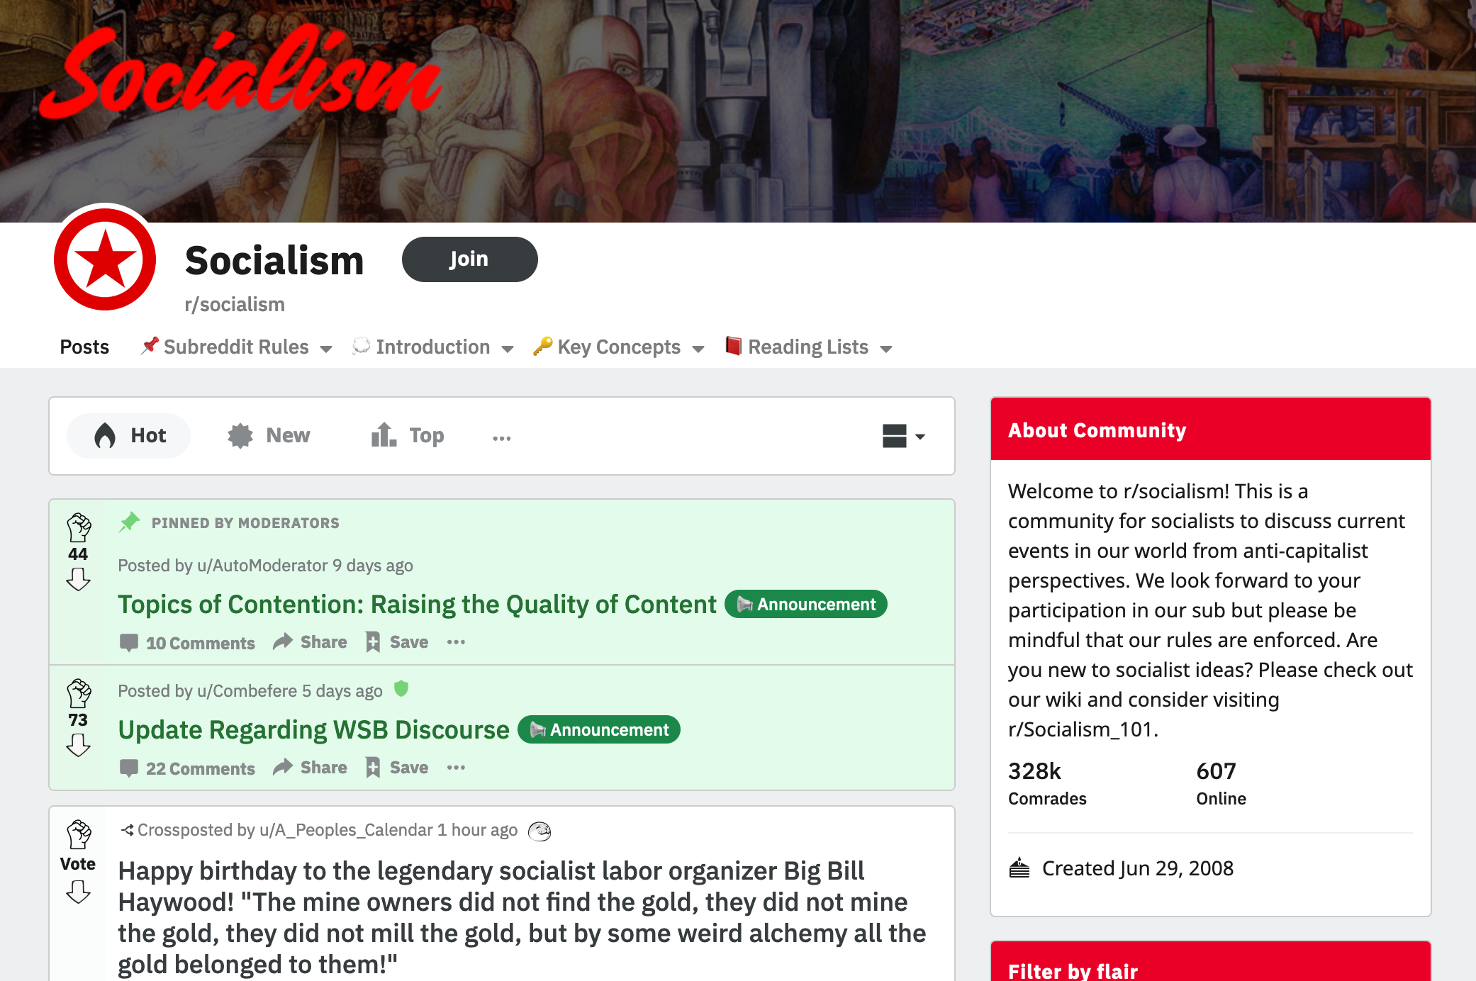
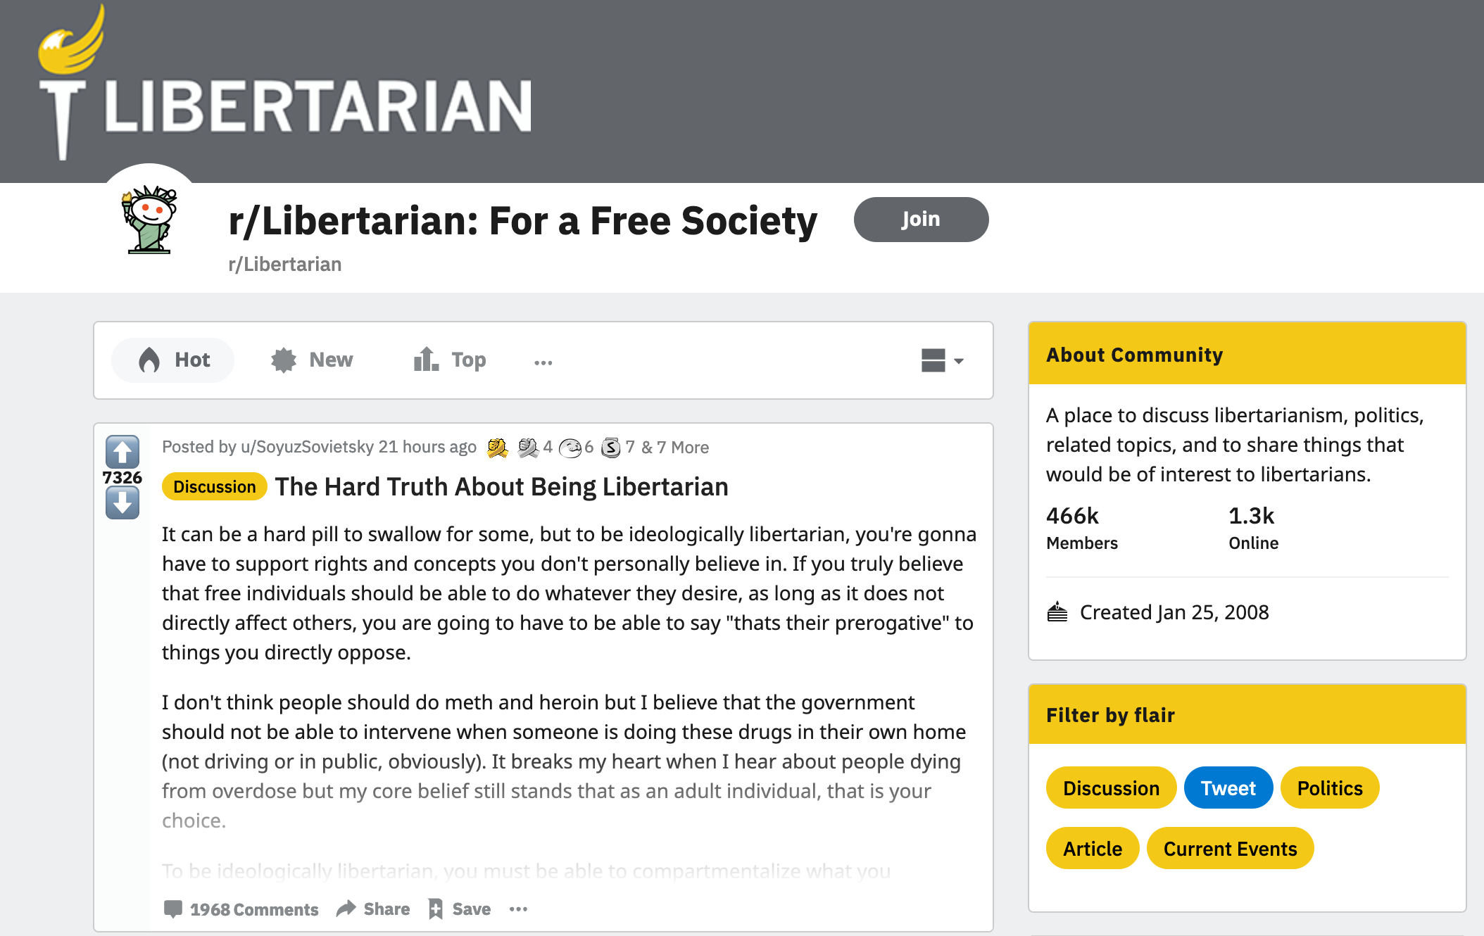

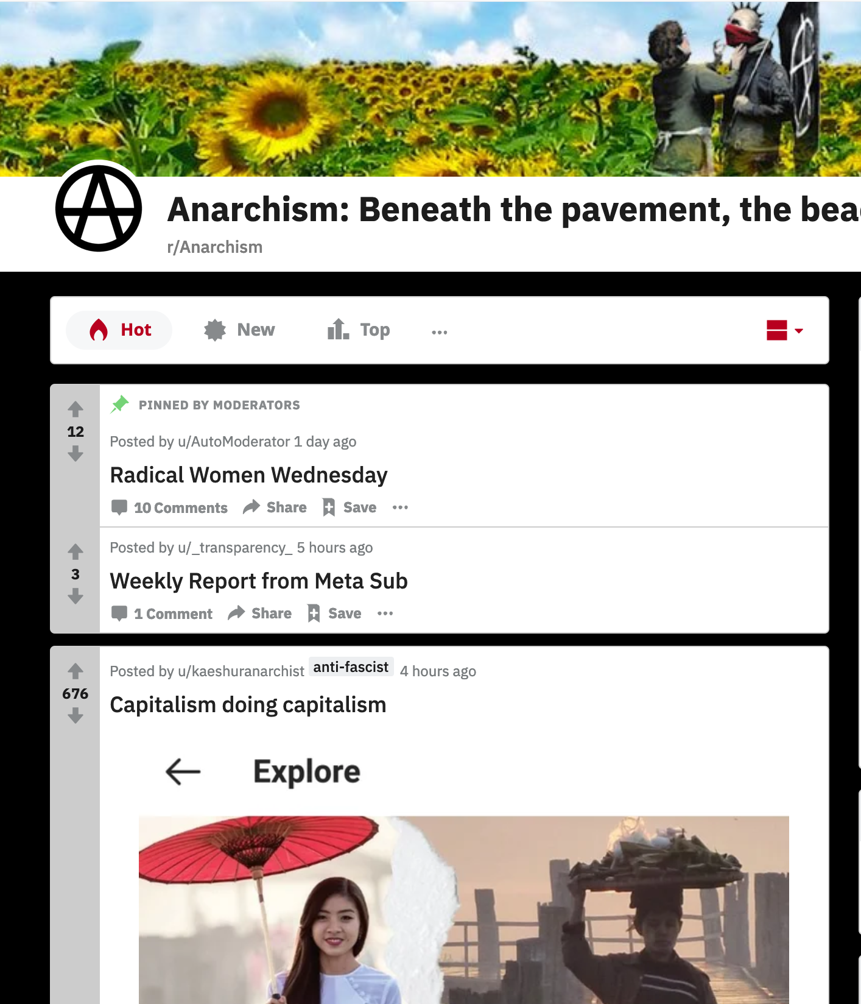
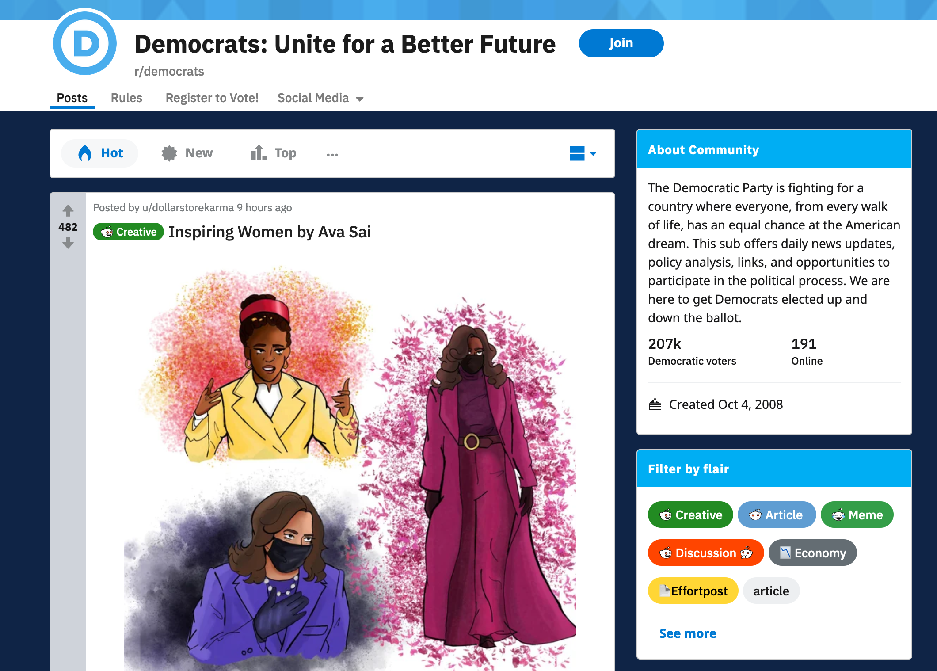
NLP analysis of socio-political opinions on reddit

Slide 2
Project Workflow:
Setup:
Data Ingestion (Reddit API from ideological subreddits with 100K+ members; so far >100K posts for 7 subreddits)
Analysis:
Classification by Ideology (i.e. subreddit) (so far with linear and rbf SVMs, clearly other options are possible)
Text Preprocessing (cleaning/filtering, tokenization, n-gramming, lemmatization, bow vectorization)
Prediction of Post Score/Upvotes/Responses (Regression, SVR etc.)
Topic Modelling (LDA (or HDP), 20 – 50 topics starting point)
Primary Tools: praw, bs4, nltk, gensim, pyLDAvis, scikit-learn

Slide 3
Topic LDA Topics for 5 political subreddits
Topic: 1
Words: 0.137*"change" + 0.047*"climate" + 0.030*"middle" + 0.026*"global" + 0.026*"climate_change" + 0.024*"mistake" + 0.019*"energy" + 0.016*"earth" + 0.016*"anarchism" + 0.015*"science"
Topic: 2
Words: 0.077*"bernie" + 0.059*"candidate" + 0.046*"biden" + 0.040*"sander" + 0.037*"campaign" + 0.035*"debate" + 0.030*"supporter" + 0.024*"poll" + 0.023*"running" + 0.018*"moderate"
Topic: 3
Words: 0.095*"libertarian" + 0.026*"gender" + 0.022*"people" + 0.019*"individual" + 0.019*"woman" + 0.016*"social" + 0.015*"trans" + 0.014*"liberty" + 0.013*"male" + 0.013*"libertarianism"
Topic: 4
Words: 0.124*"government" + 0.104*"state" + 0.029*"law" + 0.027*"property" + 0.024*"private" + 0.015*"citizen" + 0.014*"united" + 0.013*"power" + 0.013*"right" + 0.013*"federal"
Topic: 5
Words: 0.101*"white" + 0.078*"black" + 0.070*"people" + 0.062*"racist" + 0.039*"twitter" + 0.029*"racism" + 0.028*"race" + 0.027*"status" + 0.021*"minority" + 0.016*"think"
Topic: 6
Words: 0.060*"violence" + 0.043*"crime" + 0.035*"city" + 0.031*"people" + 0.022*"violent" + 0.018*"illegal" + 0.013*"event" + 0.013*"standard" + 0.010*"town" + 0.009*"drug"
Topic: 7
Words: 0.078*"class" + 0.052*"working" + 0.036*"worker" + 0.032*"movement" + 0.026*"union" + 0.021*"working_class" + 0.019*"people" + 0.016*"struggle" + 0.015*"strike" + 0.012*"rich"
Topic: 8
Words: 0.110*"money" + 0.060*"time" + 0.024*"wealth" + 0.022*"dollar" + 0.020*"million" + 0.020*"spend" + 0.015*"long" + 0.014*"library" + 0.014*"giving" + 0.013*"spent"

Slide 4
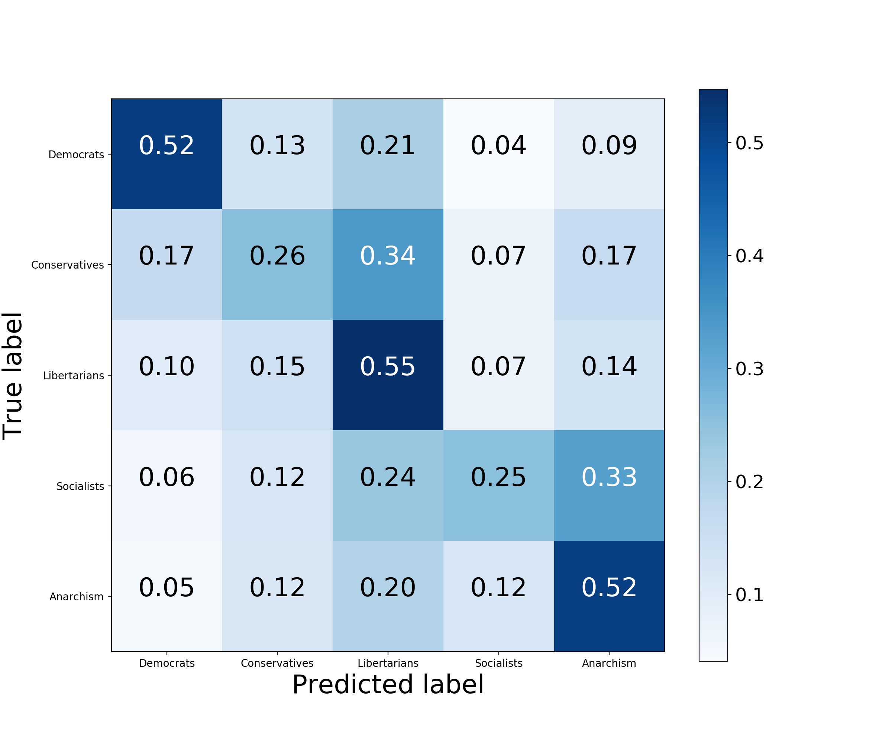
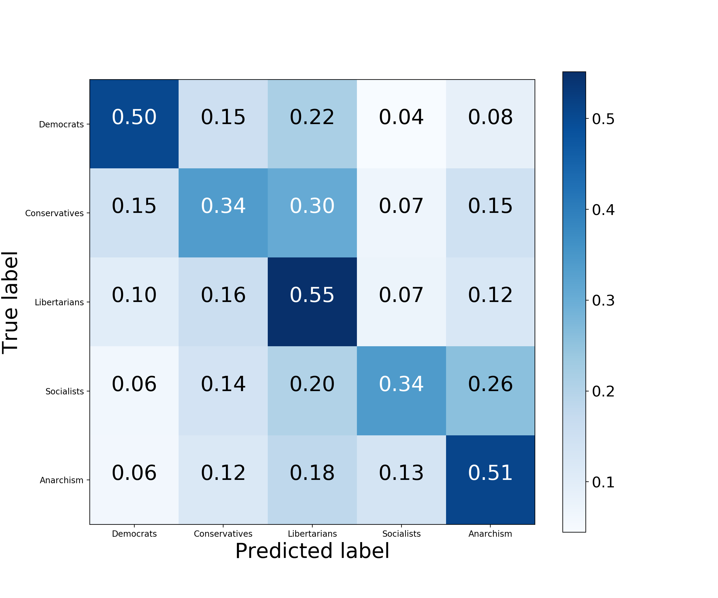
Modelling of 5 subreddits with 50 topics
Modelling of 5 subreddits with 500 topics

Slide 5
Novelty:
Topic-modelling not often used as a preprocessing step for text classification…
…but may provide more informative/actionable information to end-users
Goes beyond sentiment analysis (scores/upvotes correlate only weakly with post sentiment as assessed with VADER)
Extracted topics may generalize across discourse domains with different formats

Slide 6
Applications for end users:
Identifying political ideology of users based upon posts/comments
Predicting which posts or users may be most influential
Tracking shifts in discourse topics/themes over time
Helping clients themselves select topics for messages targeted to specific ideological groups
(Not limited to Reddit; just a convenient starting point)

